Slide 1

Daniele Berretta
Andrea Cencio
Mohamed Khaled
Cybersecurity for Embedded Systems (01UDNOV)
Academic Year: 2021/2022 Project Track 16 – Secure Over the Air update (OTA)

Slide 2
Project Outline Main Points
Introduction to Over The Air Update
General presentation of project solution
Cybersecurity point of view
Communication Protocol
Operational and Update Architecture
Demo Video

Slide 3

Over The Air Update Features:
Install new firmware
Fix bugs
No wires
No physical need
Over The Air
Update Drawbacks:
There is no standard
Possible attacks

Slide 4
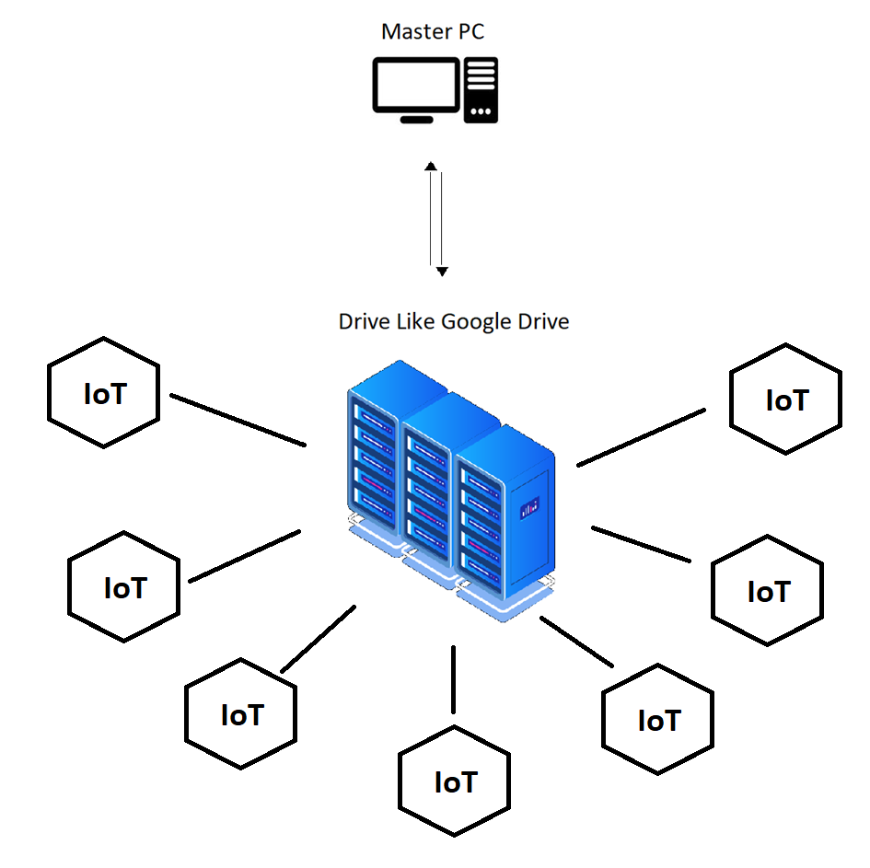
Inter Cluster OTA Update
Over-The-Air Secure Update.
The protocol is developed for updating N control units connected to the network in a safe manner and with a guarantee of origin and integrity.
Actors:
PC for Upload Interface
Server (Google Drive)
IoT (with EPS32)

Slide 5
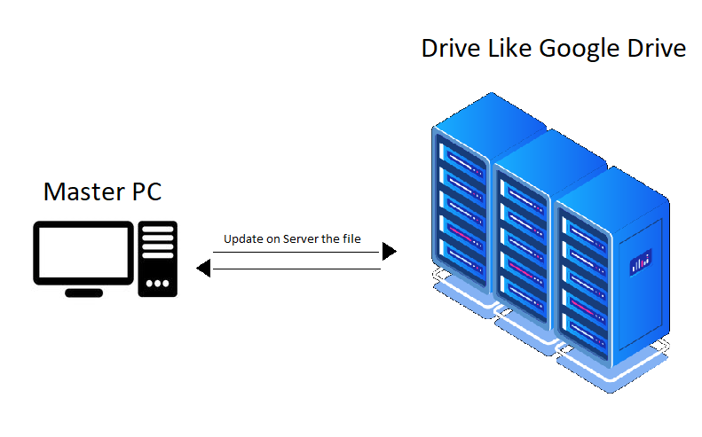
Upload the updates Files on Server
In this Section we need to upload the file on the web server.
In our case we are using Google drive as server.
From any PC with correct credential is possible to login and load the new update firmware for the IoT devices

Slide 6
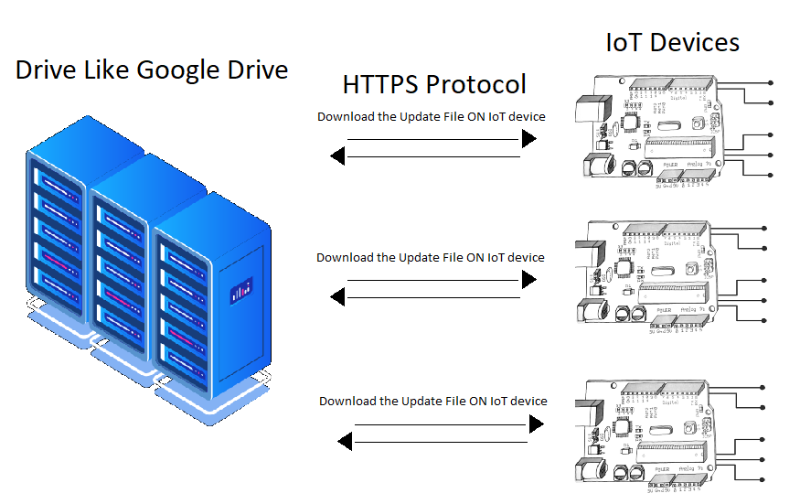
Download files on IoT device
Each IoT device is connected on Internet and can Request to the server if there is an Update in his software.
If the file is different from the one that already use, the update procedure starts.

Slide 7

Cybersecurity point of view
How to make the update Process Secure:
Protecting the update Integrity
we don’t want anyone to modify the update
Protecting the update Authentication
We want to make sure that the update is from the original OEM
Protecting the update Authenticity
We want to make sure that the update is sent to the required device
Protecting the update Confidentiality
We don’t want the firmware to be read by anyone

Slide 8
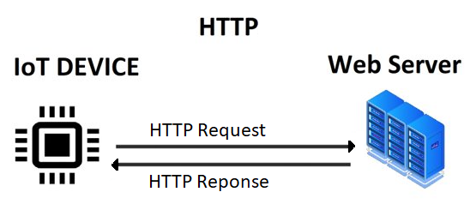
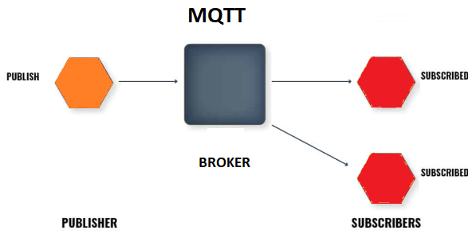
HTTP vs MQTT
HTTP Hypertext Transfer Protocol
Client-Server model communication
- Client send Request to Server
- Server Responds to the request with the resource
MQTT Message Queuing Telemetry Transport
Publish-subscribe model
- Publishers: public the message
- Subscribers: receive the message published (if subscribed to the topic)

Slide 9
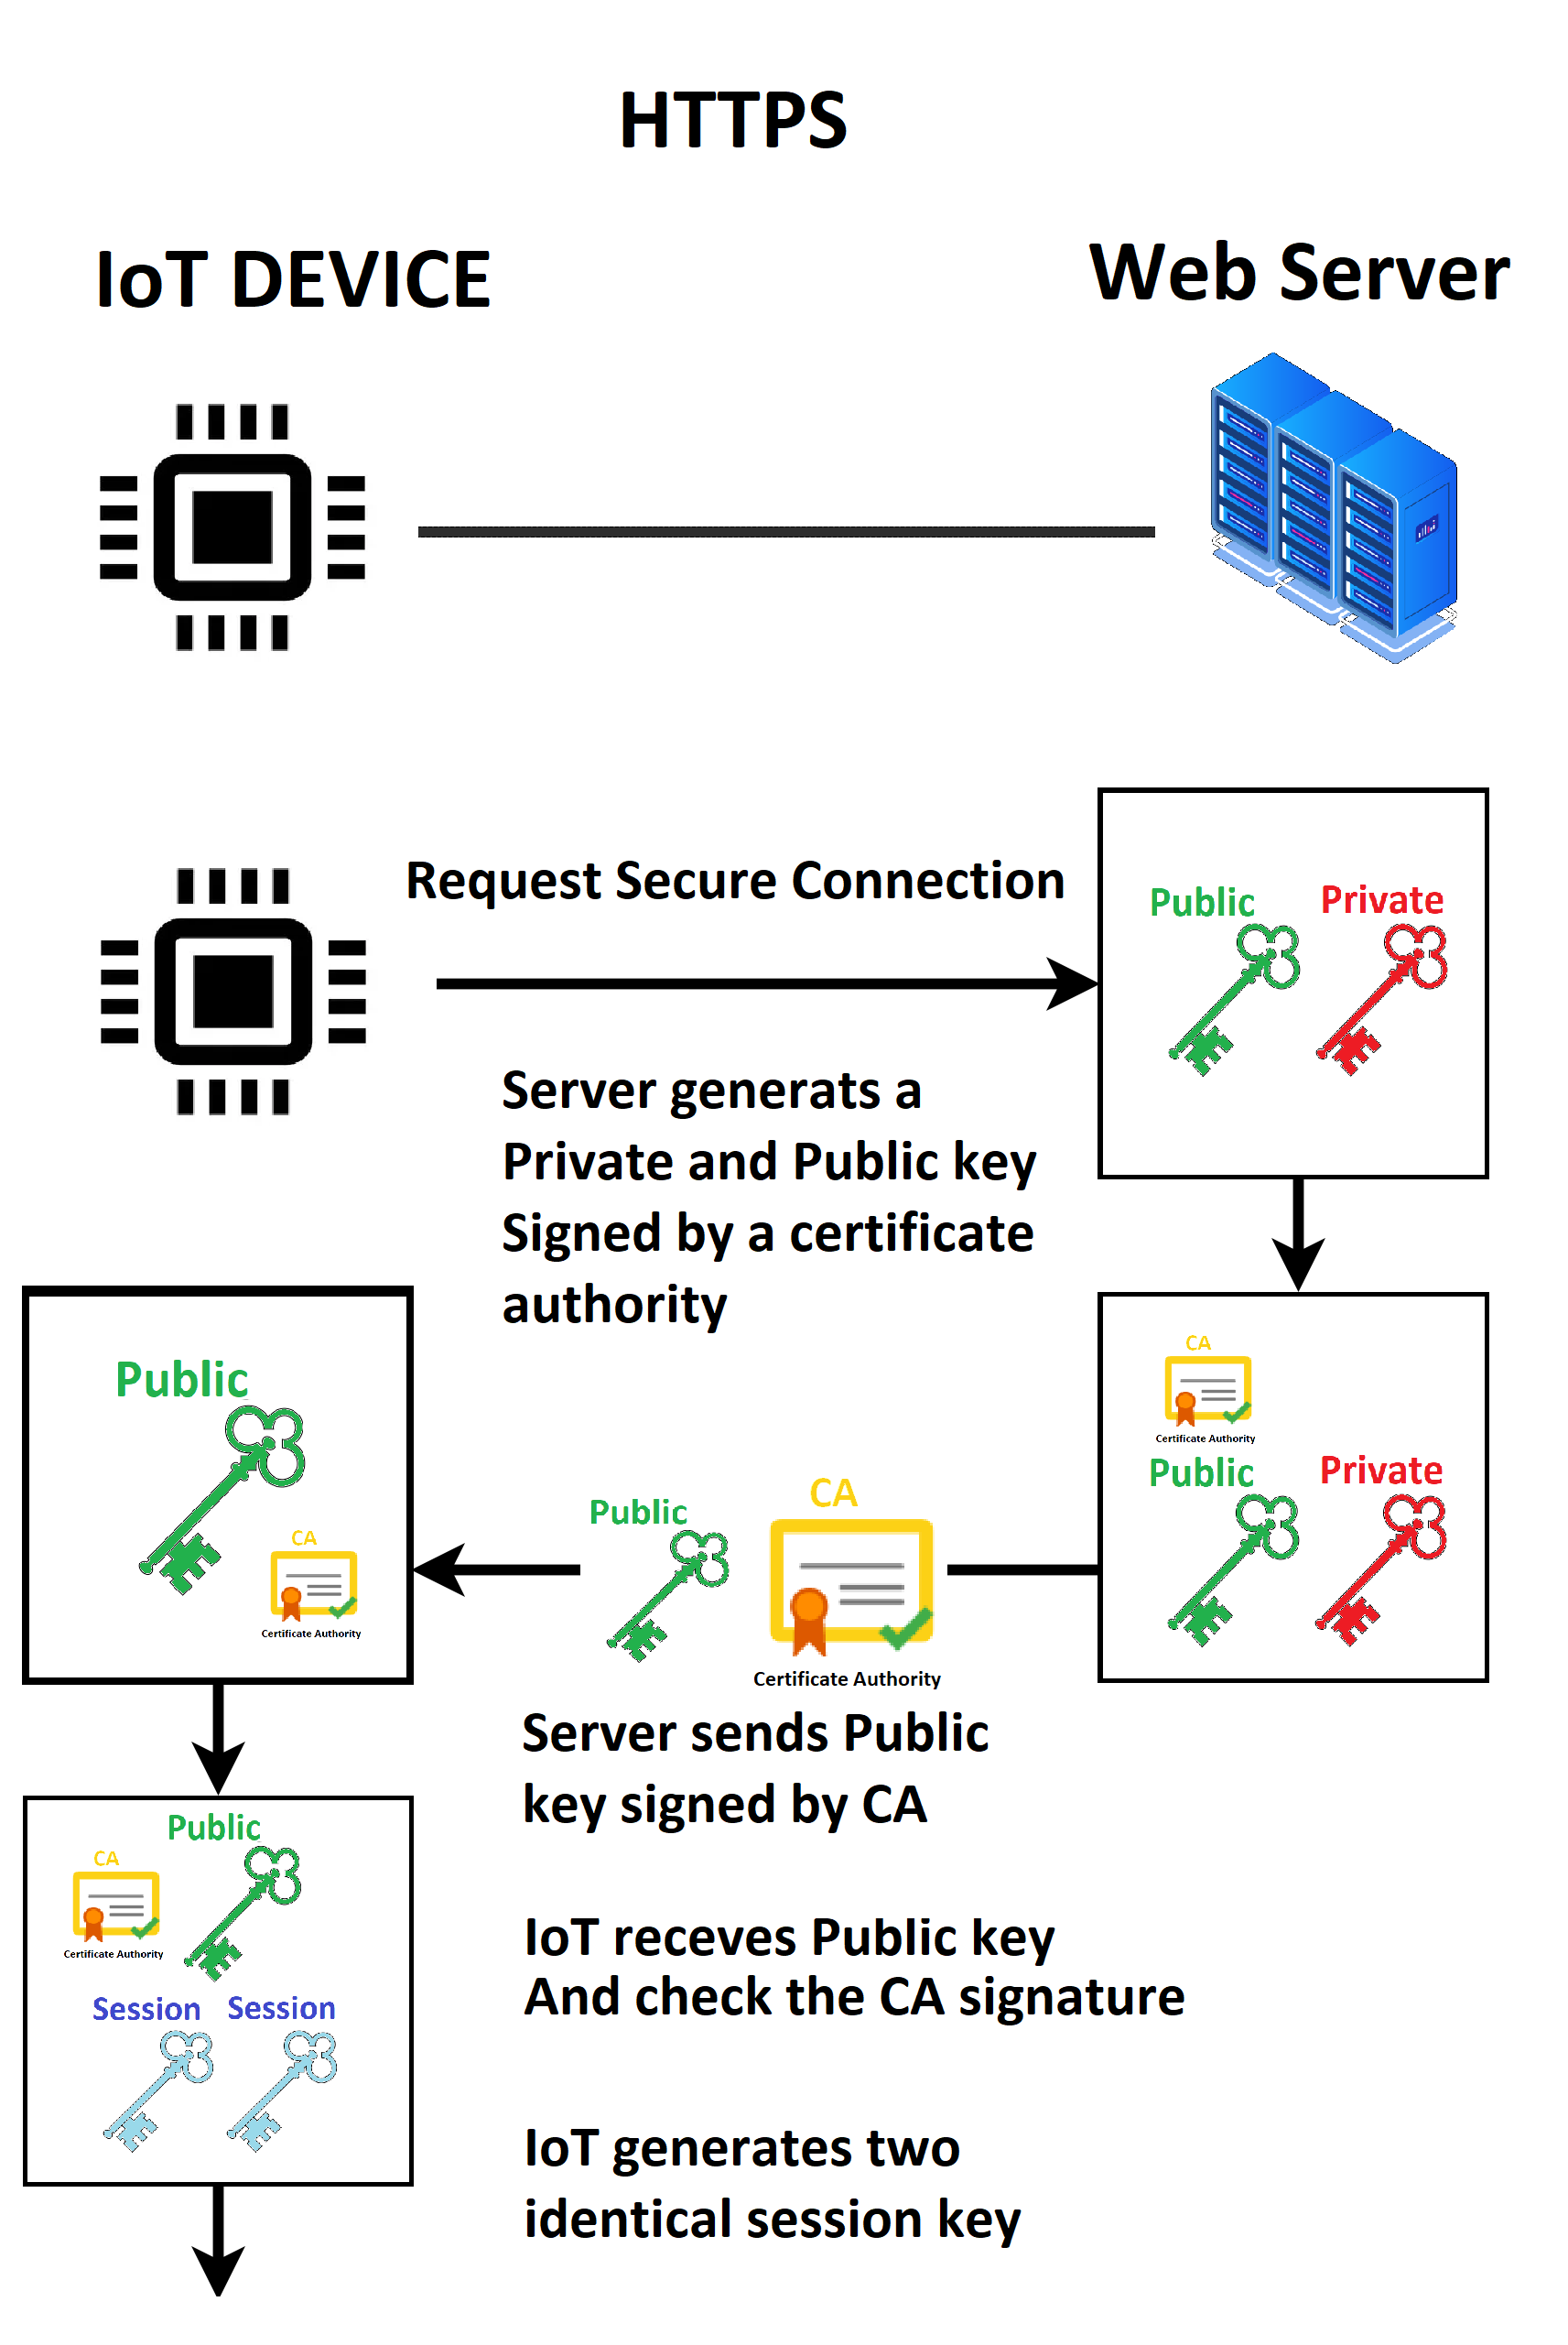
Communication Protocol HTTPS
Request secure connection
Server receives request and generates two asymmetric keys one public and one private
Server sends public key to IoT with the Certificate Authority signature
IoT keeps public key and check the CA signature
If IoT trust the CA, generates two identical encryption keys (session keys)

Slide 10
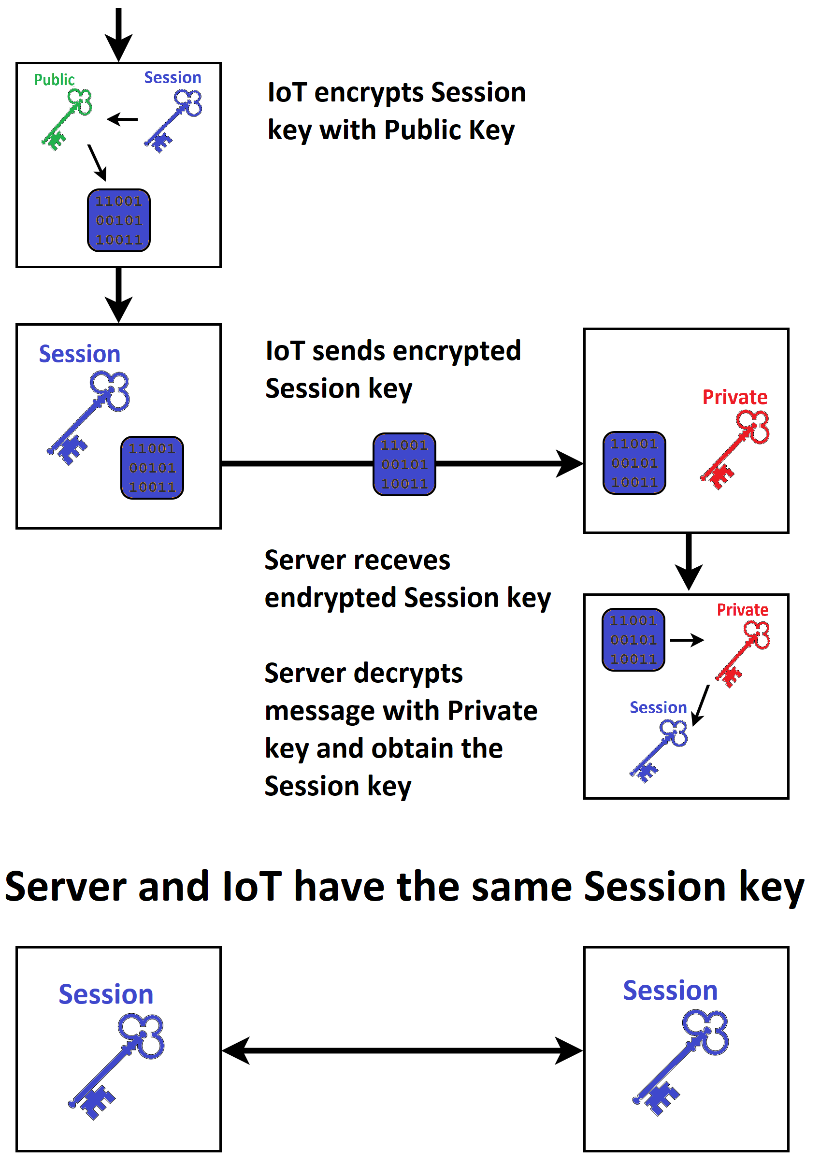
Communication Protocol HTTPS
IoT encrypts session key using public key and send the encrypted key to the server
Server decrypts the message with his private key
The two parts have an identical key and can communicate securely

Slide 11
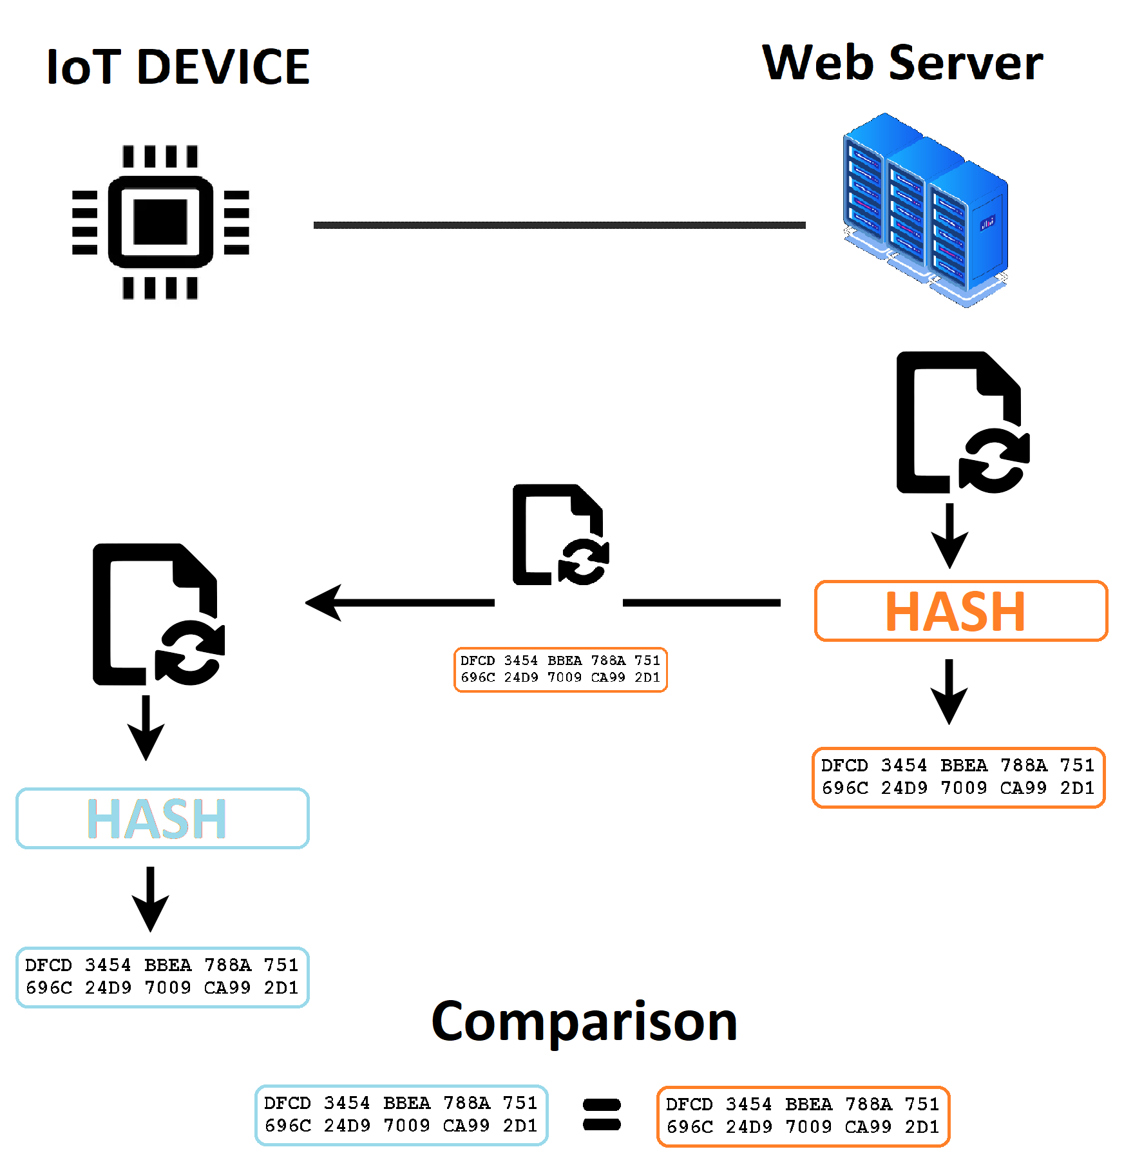
Hash Integrity function
to ensure the integrity of the update, the server digests the file using the hash function and encrypts it with session key
Server sends Update file and encrypted hash to IoT
IoT in turn digests the received file with hash function and compare the result with the server’s hash

Slide 12
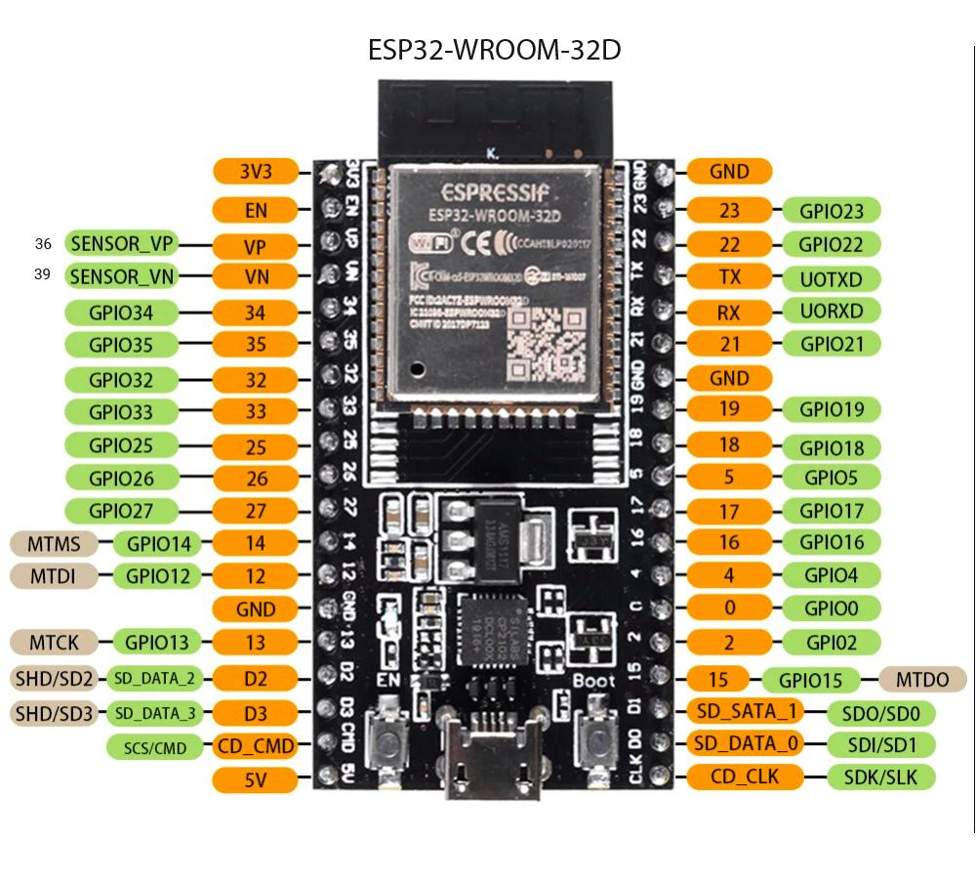

EPS32 FreeRTOS
The project is developed using a ESP32 board. This cheap board with integrated WIFI connectivity, it is a good tool for project development.
On the ESP32 we are running freeRTOS as operating system (Real Time OS with a free MIT license)
Our environment :
ESP-IDF(the official framework for esp32)
Visual Studio Code

Slide 13
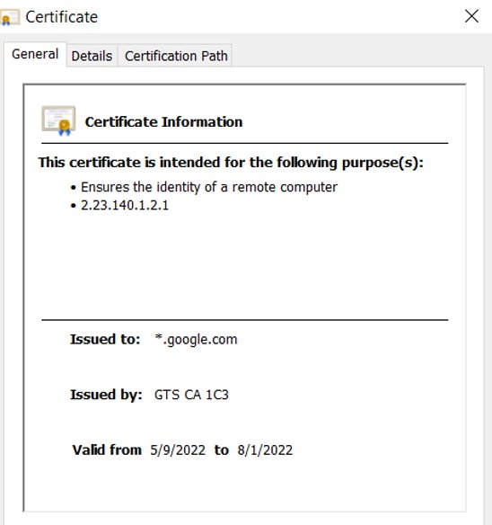
Requirements for OTA Process
Binary file secured with https(google drive)
Certificate(must be embedded into our chips)
Internet Connection
Memory partitions
Trigger the OTA process(Interrupt)
Push button

Slide 14
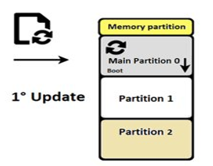
Boot and software update
OTA Mechanism​
Each partition size is 1 MB
OTA data Partition
Running main Partition (version1)
Update file is ready (version2)
Triggering update process
Push the update file into partition1
Update ota data partition
Restart our chip

Slide 15
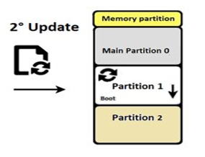
Boot and software update
OTA Mechanism​
Running Partition1 (version2)
Update file is ready(version3)
Triggering update process
Push the update file into partition2
Update ota data partition
Restart our chip

Slide 16
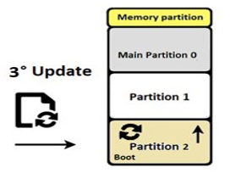
Boot and software update
OTA Mechanism​
Running Partition1 (version3)
Update file is ready (version4)
Triggering update process
Push the update file into partition1
Update ota data partition
Restart our chip

Slide 17
OTA Mechanism
Pros
Cons
Backup original version
Avoid overwriting
It is suitable with:
1)chips with large size flash memory
2)small programs
Not suitable for large programs
Memory efficiency is up to 33%

Slide 18


Slide 19
Thank you
Daniele Berretta
Andrea Cencio
Mohamed Khaled

